Slide 1
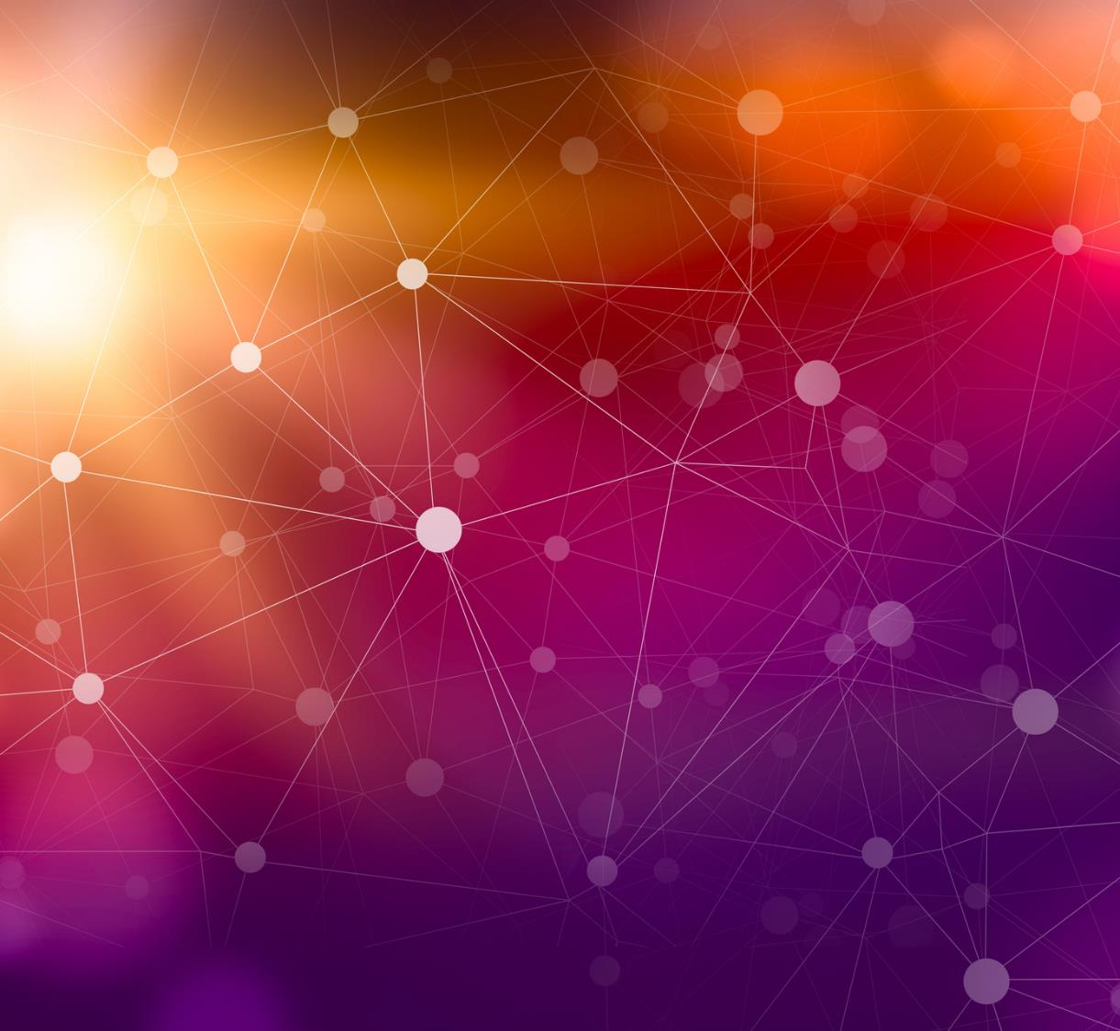
LLM based Document Information Extraction
Ashish Easow

Slide 2
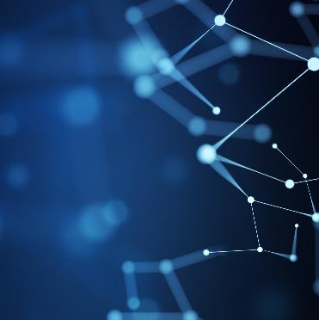
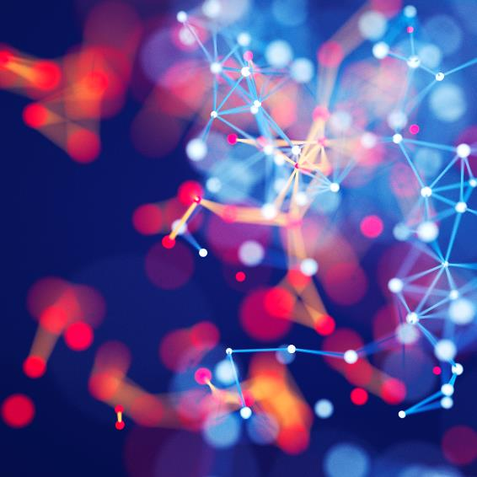
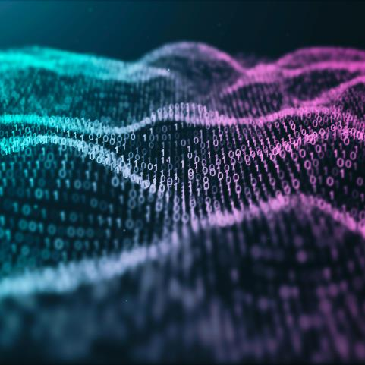
Agenda
Introduction
Design
Demo
Conclusion

Slide 3
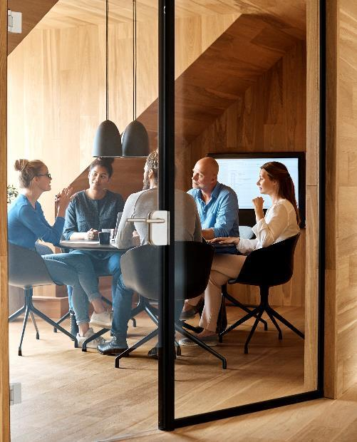
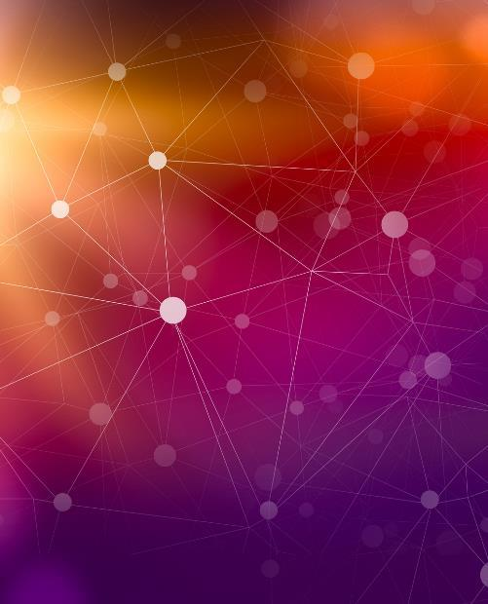

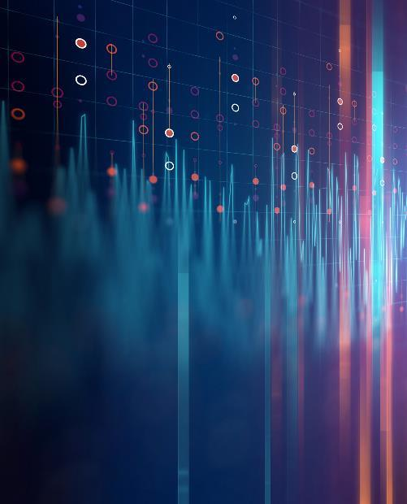
Introduction
Digital document reading use cases are none of the most common ones used by enterprises to get benefits from automation programs and Large language models like ChatGPT, Bard, LLAMA2 amongst others are at the forefront of digital innovation. So, what's stopping us from combining both.

Slide 4
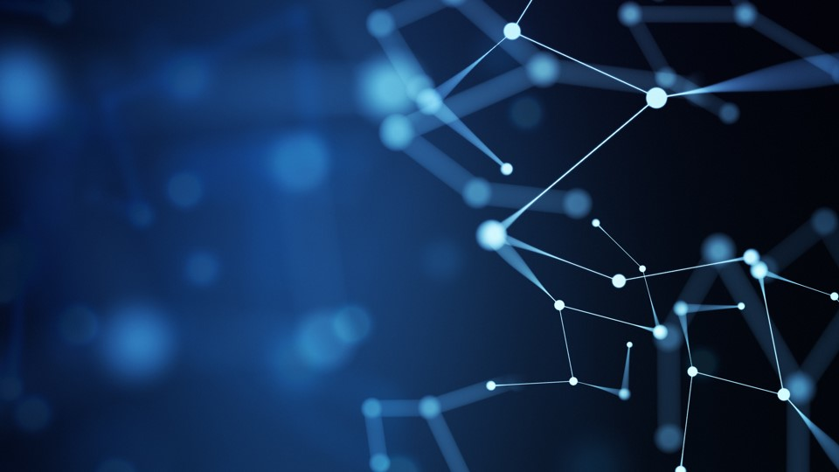



Architecture
1. Read Raw/Unstructured data from documents
LLM
Structured or Unstructured
2. Integrate with LLM
Python
Documents Folder
3. Produce structured output by LLM as described by prompt
Applications
RPA/BP
4. Enter into applications by RPA

Slide 5

Conclusion
With the integration of LLM’s the previous task which required ML training, preparation, and quite bit of development today can be done in 1/10th or less of time and effort. This demo just took me a few hours, though I’ll be honest and say every software has its own caveats and it won't be as simple as a snap.

